Slide 1
CSE 3120
Review of Object-Oriented Programming and Java
slides created by Marty Stepp
also based on course materials by Stuart Reges
http://www.cs.washington.edu/331/

Slide 2
Primitives vs. objects; value and reference semantics

Slide 3
A swap method?
Does the following swap method work? Why or why not?
  public static void main(String[] args) {
  int a = 7;
  int b = 35;
  // swap a with b?
  swap(a, b);
  System.out.println(a + " " + b);
  }
  public static void swap(int a, int b) {
  int temp = a;
  a = b;
  b = temp;
  }
Notes:
It's basically not possible to write a swap method that accepts two ints.
swap can't escape from itself to modify the outside world.
(sort of like the villains in the holodeck on Star Trek; they can wreak havoc in their holo-world, but they can't leave and attack the real Enterprise outside.)

Slide 4
Value semantics
value semantics: Behavior where values are copied when assigned, passed as parameters, or returned.
  All primitive types in Java use value semantics.
  When one variable is assigned to another, its value is copied.
  Modifying the value of one variable does not affect others.
  int x = 5;
  int y = x; // x = 5, y = 5
  y = 17; // x = 5, y = 17
  x = 8; // x = 8, y = 17

Slide 5
Reference semantics (objects)
reference semantics: Behavior where variables actually store the address of an object in memory.
  When one variable is assigned to another, the object is
  not copied; both variables refer to the same object.
  Modifying the value of one variable will affect others.
  int[] a1 = {4, 15, 8};
  int[] a2 = a1; // refer to same array as a1
  a2[0] = 7;
  System.out.println(Arrays.toString(a1)); // [7, 15, 8]
index | 0 | 1 | 2
value | 4 | 15 | 8
index | 0 | 1 | 2
value | 7 | 15 | 8
a1
a2

Slide 6

References and objects
Arrays and objects use reference semantics. Why?
  efficiency. Copying large objects slows down a program.
  sharing. It's useful to share an object's data among methods.
  DrawingPanel panel1 = new DrawingPanel(80, 50);
  DrawingPanel panel2 = panel1; // same window
  panel2.setBackground(Color.CYAN);
panel1
panel2

Slide 7

Objects as parameters
When an object is passed as a parameter, the object is not copied. The parameter refers to the same object.
  If the parameter is modified, it will affect the original object.
  public static void main(String[] args) {
  DrawingPanel window = new DrawingPanel(80, 50);
  window.setBackground(Color.YELLOW);
  example(window);
  }
  public static void example(DrawingPanel panel) {
  panel.setBackground(Color.CYAN);
  ...
  }
window
panel
Notes:
Note: This is also the reason that it works when you pass the Graphics g as a parameter to a method, because it is drawing with the same pen object onto the same window.

Slide 8
Arrays as parameters
Arrays are also passed as parameters by reference.
  Changes made in the method are also seen by the caller.
  public static void main(String[] args) {
  int[] iq = {126, 167, 95};
  increase(iq);
  System.out.println(Arrays.toString(iq));
  }
  public static void increase(int[] a) {
  for (int i = 0; i < a.length; i++) {
  a[i] = a[i] * 2;
  }
  }
  Output:
  [252, 334, 190]
iq
index | 0 | 1 | 2
value | 126 | 167 | 95
index | 0 | 1 | 2
value | 252 | 334 | 190
a

Slide 9
Arrays pass by reference
Arrays are also passed as parameters by reference.
  Changes made in the method are also seen by the caller.
  public static void main(String[] args) {
  int[] iq = {126, 167, 95};
  increase(iq);
  System.out.println(Arrays.toString(iq));
  }
  public static void increase(int[] a) {
  for (int i = 0; i < a.length; i++) {
  a[i] = a[i] * 2;
  }
  }
  Output:
  [252, 334, 190]
iq
index | 0 | 1 | 2
value | 126 | 167 | 95
index | 0 | 1 | 2
value | 252 | 334 | 190
a

Slide 10
Classes and Objects

Slide 11
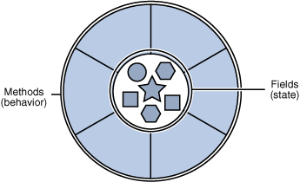
Objects
object: An entity that encapsulates data and behavior.
  data: variables inside the object
  behavior: methods inside the object
    You interact with the methods;
    the data is hidden in the object.
Constructing (creating) an object:
  Type objectName = new Type(parameters);
Calling an object's method:
  objectName.methodName(parameters);

Slide 12
Classes
class: A program entity that represents either:
  1. A program / module, or
  2. A template for a new type of objects.
object-oriented programming (OOP): Programs that perform their behavior as interactions between objects.
  abstraction: Separation between concepts and details.
  Objects and classes provide abstraction in programming.

Slide 13
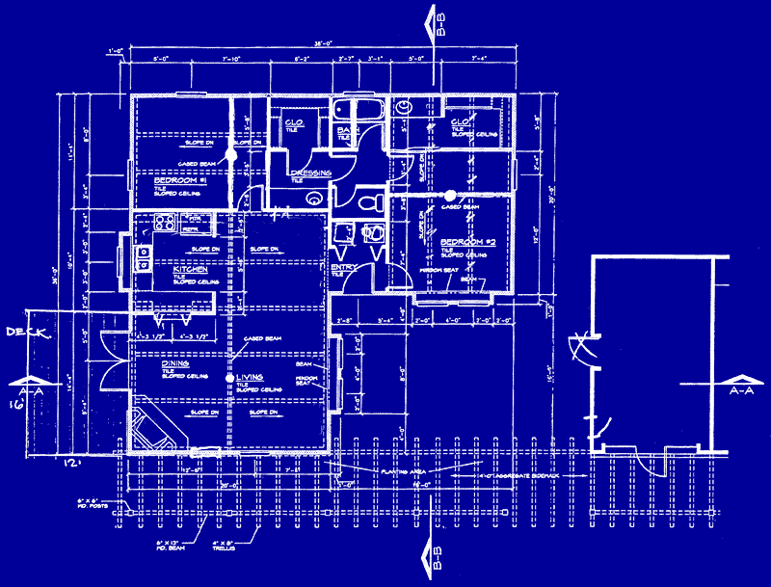
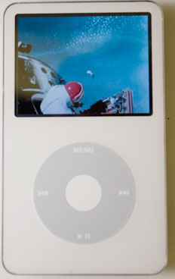
Blueprint analogy
iPod blueprint
state:
current song
volume
battery life
behavior:
power on/off
change station/song
change volume
choose random song
creates
iPod #1
state:
song = "1,000,000 Miles"
volume = 17
battery life = 2.5 hrs
behavior:
power on/off
change station/song
change volume
choose random song
iPod #2
state:
song = "Letting You"
volume = 9
battery life = 3.41 hrs
behavior:
power on/off
change station/song
change volume
choose random song
iPod #3
state:
song = "Discipline"
volume = 24
battery life = 1.8 hrs
behavior:
power on/off
change station/song
change volume
choose random song

Slide 14
Point objects
  import java.awt.*;
  ...
  Point p1 = new Point(5, -2);
  Point p2 = new Point(); // origin (0, 0)
Data:
Methods:
Name | Description
x | the point's x-coordinate
y | the point's y-coordinate
Name | Description
setLocation(x, y) | sets the point's x and y to the given values
translate(dx, dy) | adjusts the point's x and y by the given amounts
distance(p) | how far away the point is from point p

Slide 15
Point class as blueprint
Point class
state each object should receive:
int x, y
behavior each object should receive:
setLocation(int x, int y)
translate(int dx, int dy)
distance(Point p)
  The class (blueprint) describes how to create objects.
  Each object contains its own data and methods.
    The methods operate on that object's data.
Point object #1
state:
x = 51 y = -2
behavior:
setLocation(int x, int y)
translate(int dx, int dy)
distance(Point p)
Point object #2
state:
x = -24 y = 137
behavior:
setLocation(int x, int y)
translate(int dx, int dy)
distance(Point p)
Point object #3
state:
x = 18 y = 42
behavior:
setLocation(int x, int y)
translate(int dx, int dy)
distance(Point p)

Slide 16

Clients of objects
client program: A program that uses objects.
  Example: Bomb is a client of DrawingPanel and Graphics.
Bomb.java (client program)
public class Bomb {
main(String[] args) {
new DrawingPanel(...)
new DrawingPanel(...)
...
}
}
DrawingPanel.java (class)
public class DrawingPanel {
...
}

Slide 17
Fields
field: A variable inside an object that is part of its state.
  Each object has its own copy of each field.
Declaration syntax:
  private type name;
  Example:
  public class Point {
  private int x;
  private int y;
  ...
  }

Slide 18
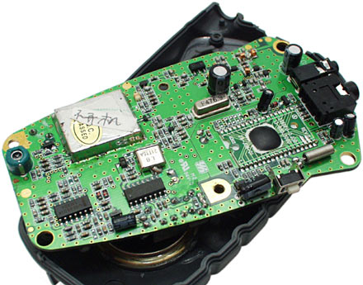
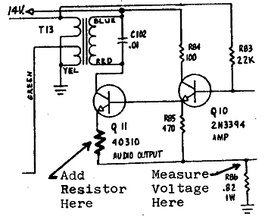
Encapsulation
encapsulation: Hiding implementation details from clients.
  Encapsulation enforces abstraction.
    separates external view (behavior) from internal view (state)
    protects the integrity of an object's data

Slide 19
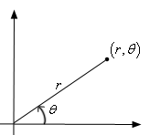
Benefits of encapsulation
Abstraction between object and clients
Protects object from unwanted access
  Example: Can't fraudulently increase an Account's balance.
Can change the class implementation later
  Example: Point could be rewritten in polar
  coordinates (r, θ) with the same methods.
Can constrain objects' state (invariants)
  Example: Only allow Accounts with non-negative balance.
  Example: Only allow Dates with a month from 1-12.

Slide 20
Instance methods
instance method (or object method): Exists inside each object of a class and gives behavior to each object.
  public type name(parameters) {
  statements;
  }
  same syntax as static methods, but without static keyword
  Example:
  public void tranlate(int dx, int dy) {
  x += dx;
  y += dy;
  }

Slide 21
The implicit parameter
implicit parameter:
The object on which an instance method is being called.
  If we have a Point object p1 and call p1.translate(5, 3);
  the object referred to by p1 is the implicit parameter.
  If we have a Point object p2 and call p2.translate(4, 1);
  the object referred to by p2 is the implicit parameter.
  The instance method can refer to that object's fields.
    We say that it executes in the context of a particular object.
    translate can refer to the x and y of the object it was called on.

Slide 22
Categories of methods
accessor: A method that lets clients examine object state.
  Examples: distance, distanceFromOrigin
  often has a non-void return type
mutator: A method that modifies an object's state.
  Examples: setLocation, translate
helper: Assists some other method in performing its task.
  often declared as private so outside clients cannot call it

Slide 23
The toString method
tells Java how to convert an object into a String for printing
  public String toString() {
  code that returns a String representing this object;
  }
  Method name, return, and parameters must match exactly.
  Example:
  // Returns a String representing this Point.
  public String toString() {
  return "(" + x + ", " + y + ")";
  }

Slide 24
Constructors
constructor: Initializes the state of new objects.
  public type(parameters) {
  statements;
  }
  runs when the client uses the new keyword
  no return type is specified; implicitly "returns" the new object
  public class Point {
  private int x;
  private int y;
  public Point(int initialX, int initialY) {
  x = initialX;
  y = initialY;
  }

Slide 25
Multiple constructors
A class can have multiple constructors.
  Each one must accept a unique set of parameters.
Example: A Point constructor with no parameters that initializes the point to (0, 0).
  // Constructs a new point at (0, 0).
  public Point() {
  x = 0;
  y = 0;
  }

Slide 26
The keyword this
this : Refers to the implicit parameter inside your class.
  (a variable that stores the object on which a method is called)
  Refer to a field: this.field
  Call a method: this.method(parameters);
  One constructor this(parameters);
  can call another:

Slide 27
Calling another constructor
  public class Point {
  private int x;
  private int y;
  public Point() {
  this(0, 0);
  }
  public Point(int x, int y) {
  this.x = x;
  this.y = y;
  }
  ...
  }
    Avoids redundancy between constructors
    Only a constructor (not a method) can call another constructor

Slide 28
Comparing objects for equality and ordering

Slide 29
Comparing objects
The == operator does not work well with objects.
  == compares references to objects, not their state.
  It only produces true when you compare an object to itself.
  Point p1 = new Point(5, 3);
  Point p2 = new Point(5, 3);
  Point p3 = p2;
  // p1 == p2 is false;
  // p1 == p3 is false;
  // p2 == p3 is true
...
p1
x | 5 | y | 3
p2
...
x | 5 | y | 3
p3

Slide 30
The equals method
The equals method compares the state of objects.
  if (str1.equals(str2)) {
  System.out.println("the strings are equal");
  }
But if you write a class, its equals method behaves like ==
  if (p1.equals(p2)) { // false :-(
  System.out.println("equal");
  }
  This is the default behavior we receive from class Object.
  Java doesn't understand how to compare new classes by default.

Slide 31
The compareTo method (10.2)
The standard way for a Java class to define a comparison function for its objects is to define a compareTo method.
  Example: in the String class, there is a method:
  public int compareTo(String other)
A call of A.compareTo(B) will return:
  a value < 0 if A comes "before" B in the ordering,
  a value > 0 if A comes "after" B in the ordering,
  or 0 if A and B are considered "equal" in the ordering.

Slide 32
Using compareTo
compareTo can be used as a test in an if statement.
  String a = "alice";
  String b = "bob";
  if (a.compareTo(b) < 0) { // true
  ...
  }
Primitives | Objects
if (a < b) { ... | if (a.compareTo(b) < 0) { ...
if (a <= b) { ... | if (a.compareTo(b) <= 0) { ...
if (a == b) { ... | if (a.compareTo(b) == 0) { ...
if (a != b) { ... | if (a.compareTo(b) != 0) { ...
if (a >= b) { ... | if (a.compareTo(b) >= 0) { ...
if (a > b) { ... | if (a.compareTo(b) > 0) { ...

Slide 33
compareTo and collections
You can use an array or list of strings with Java's included binary search method because it calls compareTo internally.
  String[] a = {"al", "bob", "cari", "dan", "mike"};
  int index = Arrays.binarySearch(a, "dan"); // 3
Java's TreeSet/Map use compareTo internally for ordering.
  Set<String> set = new TreeSet<String>();
  for (String s : a) {
  set.add(s);
  }
  System.out.println(s);
  // [al, bob, cari, dan, mike]

Slide 34
Comparable (10.2)
public interface Comparable<E> {
public int compareTo(E other);
}
A class can implement the Comparable interface to define a natural ordering function for its objects.
A call to your compareTo method should return:
  a value < 0 if this object comes "before" the other object,
  a value > 0 if this object comes "after" the other object,
  or 0 if this object is considered "equal" to the other.
If you want multiple orderings, use a Comparator instead (see Ch. 13.1)

Slide 35
Comparable template
public class name implements Comparable<name> {
...
public int compareTo(name other) {
...
}
}

Slide 36
Comparable example
public class Point implements Comparable<Point> {
private int x;
private int y;
...
// sort by x and break ties by y
public int compareTo(Point other) {
if (x < other.x) {
return -1;
} else if (x > other.x) {
return 1;
} else if (y < other.y) {
return -1; // same x, smaller y
} else if (y > other.y) {
return 1; // same x, larger y
} else {
return 0; // same x and same y
}
}
}

Slide 37
compareTo tricks
subtraction trick - Subtracting related numeric values produces the right result for what you want compareTo to return:
  // sort by x and break ties by y
  public int compareTo(Point other) {
  if (x != other.x) {
  return x - other.x; // different x
  } else {
  return y - other.y; // same x; compare y
  }
  }
  The idea:
    if x > other.x, then x - other.x > 0
    if x < other.x, then x - other.x < 0
    if x == other.x, then x - other.x == 0
      NOTE: This trick doesn't work for doubles (but see Math.signum)

Slide 38
compareTo tricks 2
delegation trick - If your object's fields are comparable (such as strings), use their compareTo results to help you:
  // sort by employee name, e.g. "Jim" < "Susan"
  public int compareTo(Employee other) {
  return name.compareTo(other.getName());
  }
toString trick - If your object's toString representation is related to the ordering, use that to help you:
  // sort by date, e.g. "09/19" > "04/01"
  public int compareTo(Date other) {
  return toString().compareTo(other.toString());
  }

Slide 39
Inheritance

Slide 40
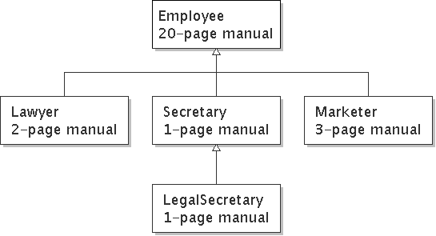
Inheritance
inheritance: Forming new classes based on existing ones.
  a way to share/reuse code between two or more classes
  superclass: Parent class being extended.
  subclass: Child class that inherits behavior from superclass.
    gets a copy of every field and method from superclass
  is-a relationship: Each object of the subclass also "is a(n)" object of the superclass and can be treated as one.

Slide 41
Inheritance syntax
  public class name extends superclass {
  Example:
  public class Lawyer extends Employee {
  ...
  }
By extending Employee, each Lawyer object now:
  receives a copy of each method from Employee automatically
  can be treated as an Employee by client code
Lawyer can also replace ("override") behavior from Employee.

Slide 42
Overriding Methods
override: To write a new version of a method in a subclass that replaces the superclass's version.
  No special syntax required to override a superclass method.
  Just write a new version of it in the subclass.
  public class Lawyer extends Employee {
  // overrides getVacationForm in Employee class
  public String getVacationForm() {
  return "pink";
  }
  ...
  }

Slide 43
The super keyword
A subclass can call its parent's method/constructor:
  super.method(parameters) // method
  super(parameters); // constructor
  public class Lawyer extends Employee {
  public Lawyer(String name) {
  super(name);
  }
  // give Lawyers a $5K raise (better)
  public double getSalary() {
  double baseSalary = super.getSalary();
  return baseSalary + 5000.00;
  }
  }

Slide 44
Subclasses and fields
public class Employee {
private double salary;
...
}
public class Lawyer extends Employee {
...
public void giveRaise(double amount) {
salary += amount; // error; salary is private
}
}
Inherited private fields/methods cannot be directly accessed by subclasses. (The subclass has the field, but it can't touch it.)
  How can we allow a subclass to access/modify these fields?

Slide 45
Protected fields/methods
protected type name; // field
protected type name(type name, ..., type name) {
statement(s); // method
}
a protected field or method can be seen/called only by:
  the class itself, and its subclasses
  also by other classes in the same "package" (discussed later)
  useful for allowing selective access to inner class implementation
public class Employee {
protected double salary;
...
}

Slide 46
Inheritance and constructors
If we add a constructor to the Employee class, our subclasses do not compile. The error:
  Lawyer.java:2: cannot find symbol
  symbol : constructor Employee()
  location: class Employee
  public class Lawyer extends Employee {
  ^
  The short explanation: Once we write a constructor (that requires parameters) in the superclass, we must now write constructors for our employee subclasses as well.

Slide 47
Inheritance and constructors
Constructors are not inherited.
  Subclasses don't inherit the Employee(int) constructor.
  Subclasses receive a default constructor that contains:
    public Lawyer() {
    super(); // calls Employee() constructor
    }
But our Employee(int) replaces the default Employee().
  The subclasses' default constructors are now trying to call a non-existent default Employee constructor.

Slide 48
Calling superclass constructor
  super(parameters);
  Example:
  public class Lawyer extends Employee {
  public Lawyer(int years) {
  super(years); // calls Employee c'tor
  }
  ...
  }
  The super call must be the first statement in the constructor.

Slide 49
Polymorphism

Slide 50
Polymorphism
polymorphism: Ability for the same code to be used with different types of objects and behave differently with each.
  System.out.println can print any type of object.
    Each one displays in its own way on the console.
  CritterMain can interact with any type of critter.
    Each one moves, fights, etc. in its own way.

Slide 51
Coding with polymorphism
A variable of type T can hold an object of any subclass of T.
  Employee ed = new Lawyer();
  You can call any methods from the Employee class on ed.
When a method is called on ed, it behaves as a Lawyer.
  System.out.println(ed.getSalary()); // 50000.0
  System.out.println(ed.getVacationForm()); // pink

Slide 52
Polymorphic parameters
You can pass any subtype of a parameter's type.
  public static void main(String[] args) {
  Lawyer lisa = new Lawyer();
  Secretary steve = new Secretary();
  printInfo(lisa);
  printInfo(steve);
  }
  public static void printInfo(Employee e) {
  System.out.println("pay : " + e.getSalary());
  System.out.println("vdays: " + e.getVacationDays());
  System.out.println("vform: " + e.getVacationForm());
  System.out.println();
  }
  OUTPUT:
  pay : 50000.0 pay : 50000.0
  vdays: 15 vdays: 10
  vform: pink vform: yellow

Slide 53
Polymorphism and arrays
Arrays of superclass types can store any subtype as elements.
  public static void main(String[] args) {
  Employee[] e = {new Lawyer(), new Secretary(),
  new Marketer(), new LegalSecretary()};
  for (int i = 0; i < e.length; i++) {
  System.out.println("pay : " + e[i].getSalary());
  System.out.println("vdays: " + i].getVacationDays());
  System.out.println();
  }
  }
  Output:
  pay : 50000.0 pay : 60000.0
  vdays: 15 vdays: 10
  pay : 50000.0 pay : 55000.0
  vdays: 10 vdays: 10

Slide 54
Casting references
A variable can only call that type's methods, not a subtype's.
  Employee ed = new Lawyer();
  int hours = ed.getHours(); // ok; in Employee
  ed.sue(); // compiler error
  The compiler's reasoning is, variable ed could store any kind of employee, and not all kinds know how to sue .
To use Lawyer methods on ed, we can type-cast it.
  Lawyer theRealEd = (Lawyer) ed;
  theRealEd.sue(); // ok
  ((Lawyer) ed).sue(); // shorter version

Slide 55
More about casting
The code crashes if you cast an object too far down the tree.
  Employee eric = new Secretary();
  ((Secretary) eric).takeDictation("hi"); // ok
  ((LegalSecretary) eric).fileLegalBriefs(); // error
  // (Secretary doesn't know how to file briefs)
You can cast only up and down the tree, not sideways.
  Lawyer linda = new Lawyer();
  ((Secretary) linda).takeDictation("hi"); // error
Casting doesn't actually change the object's behavior.
It just gets the code to compile/run.
  ((Employee) linda).getVacationForm() // pink

Slide 56
Interfaces

Slide 57
Shapes example
Consider the task of writing classes to represent 2D shapes such as Circle, Rectangle, and Triangle.
Certain operations are common to all shapes:
  perimeter: distance around the outside of the shape
  area: amount of 2D space occupied by the shape
  Every shape has these, but each computes them differently.

Slide 58
Shape area and perimeter
Circle (as defined by radius r ):
  area = π r ²
  perimeter = 2 π r
Rectangle (as defined by width w and height h ):
  area = w h
  perimeter = 2w + 2h
Triangle (as defined by side lengths a, b, and c)
  area = √(s (s - a) (s - b) (s - c))
  where s = ½ (a + b + c)
  perimeter = a + b + c
r
w
h
b
a
c

Slide 59
Common behavior
Suppose we have 3 classes Circle, Rectangle, Triangle.
  Each has the methods perimeter and area.
We'd like our client code to be able to treat different kinds of shapes in the same way:
  Write a method that prints any shape's area and perimeter.
  Create an array to hold a mixture of the various shape objects.
  Write a method that could return a rectangle, a circle, a triangle, or any other kind of shape.
  Make a DrawingPanel display many shapes on screen.

Slide 60
Interfaces
interface: A list of methods that a class can promise to implement.
  Inheritance gives you an is-a relationship and code sharing.
    A Lawyer can be treated as an Employee and inherits its code.
  Interfaces give you an is-a relationship without code sharing.
    A Rectangle object can be treated as a Shape but inherits no code.
  Analogous to non-programming idea of roles or certifications:
    "I'm certified as a CPA accountant.
    This assures you I know how to do taxes, audits, and consulting."
    "I'm 'certified' as a Shape, because I implement the Shape interface.
    This assures you I know how to compute my area and perimeter."

Slide 61
Interface syntax
  public interface name {
  public type name(type name, ..., type name);
  public type name(type name, ..., type name);
  ...
  public type name(type name, ..., type name);
  }
  Example:
  public interface Vehicle {
  public int getSpeed();
  public void setDirection(int direction);
  }

Slide 62
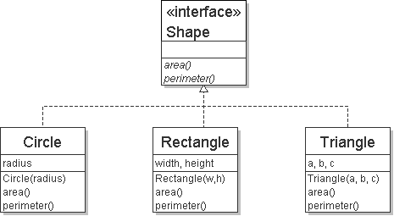
Shape interface
  // Describes features common to all shapes.
  public interface Shape {
  public double area();
  public double perimeter();
  }
  Saved as Shape.java
abstract method: A header without an implementation.
  The actual bodies are not specified, because we want to allow each class to implement the behavior in its own way.

Slide 63
Implementing an interface
  public class name implements interface {
  ...
  }
A class can declare that it "implements" an interface.
  The class promises to contain each method in that interface.
    (Otherwise it will fail to compile.)
  Example:
  public class Bicycle implements Vehicle {
  ...
  }

Slide 64
Interface requirements
  public class Banana implements Shape {
  // haha, no methods! pwned
  }
If we write a class that claims to be a Shape but doesn't implement area and perimeter methods, it will not compile.
  Banana.java:1: Banana is not abstract and does not override abstract method area() in Shape
  public class Banana implements Shape {
  ^

Slide 65
Interfaces + polymorphism
Interfaces benefit the client code author the most.
  they allow polymorphism
  (the same code can work with different types of objects)
  public static void printInfo(Shape s) {
  System.out.println("The shape: " + s);
  System.out.println("area : " + s.area());
  System.out.println("perim: " + s.perimeter());
  System.out.println();
  }
  ...
  Circle circ = new Circle(12.0);
  Triangle tri = new Triangle(5, 12, 13);
  printInfo(circ);
  printInfo(tri);

Slide 66
Abstract Classes

Slide 67
List classes example
Suppose we have implemented the following two list classes:
  ArrayList
  LinkedList
  We have a List interface to indicate that both implement a List ADT.
  Problem:
    Some of their methods are implemented the same way (redundancy).
index | 0 | 1 | 2
value | 42 | -3 | 17
data | next
42
data | next
-3
data | next
17
front

Slide 68
Common code
Notice that some of the methods are implemented the same way in both the array and linked list classes.
  add(value)
  contains
  isEmpty
Should we change our interface to a class? Why / why not?
  How can we capture this common behavior?

Slide 69
Abstract classes (9.6)
abstract class: A hybrid between an interface and a class.
  defines a superclass type that can contain method declarations (like an interface) and/or method bodies (like a class)
  like interfaces, abstract classes that cannot be instantiated
  (cannot use new to create any objects of their type)
What goes in an abstract class?
  implementation of common state and behavior that will be inherited by subclasses (parent class role)
  declare generic behaviors that subclasses implement (interface role)

Slide 70
Abstract class syntax
  // declaring an abstract class
  public abstract class name {
  ...
  // declaring an abstract method
  // (any subclass must implement it)
  public abstract type name(parameters);
  }
  A class can be abstract even if it has no abstract methods
  You can create variables (but not objects) of the abstract type

Slide 71
Abstract and interfaces
Normal classes that claim to implement an interface must implement all methods of that interface:
  public class Empty implements List {} // error
Abstract classes can claim to implement an interface without writing its methods; subclasses must implement the methods.
  public abstract class Empty implements List {} // ok
  public class Child extends Empty {} // error

Slide 72
An abstract list class
  // Superclass with common code for a list of integers.
  public abstract class AbstractList implements List {
  public void add(int value) {
  add(size(), value);
  }
  public boolean contains(int value) {
  return indexOf(value) >= 0;
  }
  public boolean isEmpty() {
  return size() == 0;
  }
  }
  public class ArrayList extends AbstractList { ...
  public class LinkedList extends AbstractList { ...

Slide 73
Abstract class vs. interface
Why do both interfaces and abstract classes exist in Java?
  An abstract class can do everything an interface can do and more.
  So why would someone ever use an interface?
Answer: Java has single inheritance.
  can extend only one superclass
  can implement many interfaces
  Having interfaces allows a class to be part of a hierarchy (polymorphism) without using up its inheritance relationship.

Slide 74
Inner Classes

Slide 75

Inner classes
inner class: A class defined inside of another class.
  can be created as static or non-static
  we will focus on standard non-static ("nested") inner classes
usefulness:
  inner classes are hidden from other classes (encapsulated)
  inner objects can access/modify the fields of the outer object

Slide 76
Inner class syntax
  // outer (enclosing) class
  public class name {
  ...
  // inner (nested) class
  private class name {
  ...
  }
  }
  Only this file can see the inner class or make objects of it.
  Each inner object is associated with the outer object that created it, so it can access/modify that outer object's methods/fields.
    If necessary, can refer to outer object as OuterClassName.this

Slide 77
Example: Array list iterator
public class ArrayList extends AbstractList {
...
// not perfect; doesn't forbid multiple removes in a row
private class ArrayIterator implements Iterator<Integer> {
private int index; // current position in list
public ArrayIterator() {
index = 0;
}
public boolean hasNext() {
return index < size();
}
public E next() {
index++;
return get(index - 1);
}
public void remove() {
ArrayList.this.remove(index - 1);
index--;
}
}
}

Slide 78
Collections

Slide 79
Collections
collection: an object that stores data; a.k.a. "data structure"
  the objects stored are called elements
  some collections maintain an ordering; some allow duplicates
  typical operations: add, remove, clear, contains (search), size
  examples found in the Java class libraries:
    ArrayList, LinkedList, HashMap, TreeSet, PriorityQueue
  all collections are in the java.util package
    import java.util.*;

Slide 80
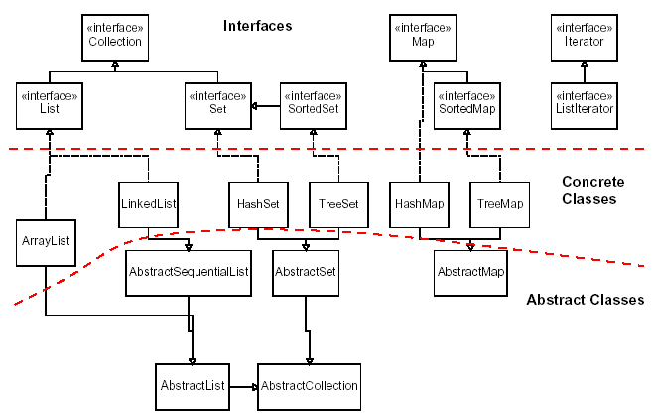
Java collection framework

Slide 81
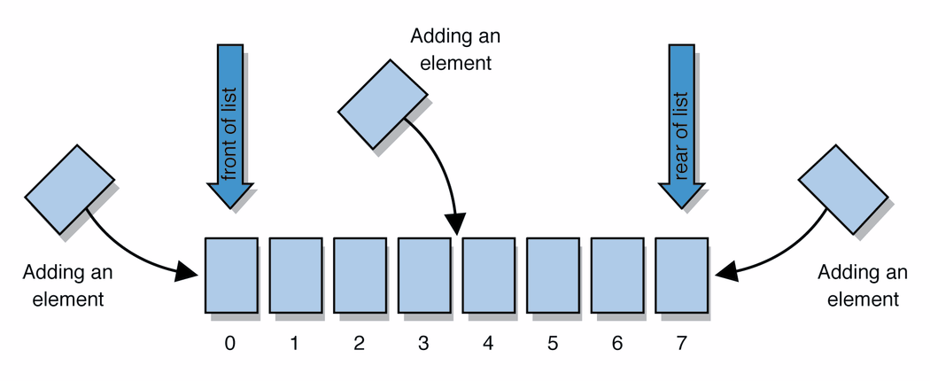
Lists
list: a collection storing an ordered sequence of elements
  each element is accessible by a 0-based index
  a list has a size (number of elements that have been added)
  elements can be added to the front, back, or elsewhere
  in Java, a list can be represented as an ArrayList object
Notes:
use jGRASP/DrJava Interactions window to create a list and add some elements, get them, check size

Slide 82
Idea of a list
Rather than creating an array of boxes, create an object that represents a "list" of items. (initially an empty list.)
  []
You can add items to the list.
  The default behavior is to add to the end of the list.
  [hello, ABC, goodbye, okay]
The list object keeps track of the element values that have been added to it, their order, indexes, and its total size.
  Think of an "array list" as an automatically resizing array object.
  Internally, the list is implemented using an array and a size field.

Slide 83
ArrayList methods (10.1)
add(value) | appends value at end of list
add(index, value) | inserts given value just before the given index, shifting subsequent values to the right
clear() | removes all elements of the list
indexOf(value) | returns first index where given value is found in list (-1 if not found)
get(index) | returns the value at given index
remove(index) | removes/returns value at given index, shifting subsequent values to the left
set(index, value) | replaces value at given index with given value
size() | returns the number of elements in list
toString() | returns a string representation of the list such as "[3, 42, -7, 15]"

Slide 84
ArrayList methods 2
addAll(list) addAll(index, list) | adds all elements from the given list to this list (at the end of the list, or inserts them at the given index)
contains(value) | returns true if given value is found somewhere in this list
containsAll(list) | returns true if this list contains every element from given list
equals(list) | returns true if given other list contains the same elements
iterator() listIterator() | returns an object used to examine the contents of the list
lastIndexOf(value) | returns last index value is found in list (-1 if not found)
remove(value) | finds and removes the given value from this list
removeAll(list) | removes any elements found in the given list from this list
retainAll(list) | removes any elements not found in given list from this list
subList(from, to) | returns the sub-portion of the list between indexes from (inclusive) and to (exclusive)
toArray() | returns the elements in this list as an array

Slide 85
Type Parameters (Generics)
List<Type> name = new ArrayList<Type>();
When constructing an ArrayList, you must specify the
type of elements it will contain between < and >.
  This is called a type parameter or a generic class.
  Allows the same ArrayList class to store lists of different types.
  List<String> names = new ArrayList<String>();
  names.add("Marty Stepp");
  names.add("Stuart Reges");

Slide 86
Stacks and queues
Sometimes it is good to have a collection that is less powerful, but is optimized to perform certain operations very quickly.
Two specialty collections:
  stack: Retrieves elements in the reverse of the order they were added.
  queue: Retrieves elements in the same order they were added.
push
pop, peek
top | 3
 | 2
bottom | 1
front |  | back
1 | 2 | 3
remove, peek
add
queue
stack

Slide 87
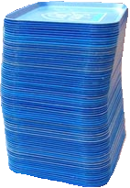
Stacks
stack: A collection based on the principle of adding elements and retrieving them in the opposite order.
  Last-In, First-Out ("LIFO")
  The elements are stored in order of insertion,
  but we do not think of them as having indexes.
  The client can only add/remove/examine
  the last element added (the "top").
basic stack operations:
  push: Add an element to the top.
  pop: Remove the top element.
  peek: Examine the top element.
push
pop, peek
top | 3
 | 2
bottom | 1
stack
Notes:
analogy: trays of food at the sizzler

Slide 88
Class Stack
  Stack<Integer> s = new Stack<Integer>();
  s.push(42);
  s.push(-3);
  s.push(17); // bottom [42, -3, 17] top
  System.out.println(s.pop()); // 17
  Stack has other methods, but you should not use them.
Stack<E>() | constructs a new stack with elements of type E
push(value) | places given value on top of stack
pop() | removes top value from stack and returns it; throws EmptyStackException if stack is empty
peek() | returns top value from stack without removing it; throws EmptyStackException if stack is empty
size() | returns number of elements in stack
isEmpty() | returns true if stack has no elements

Slide 89
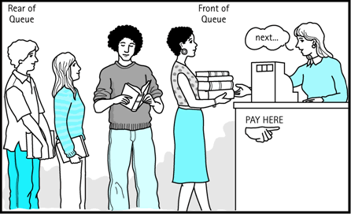
Queues
queue: Retrieves elements in the order they were added.
  First-In, First-Out ("FIFO")
  Elements are stored in order of
  insertion but don't have indexes.
  Client can only add to the end of the
  queue, and can only examine/remove
  the front of the queue.
basic queue operations:
  add (enqueue): Add an element to the back.
  remove (dequeue): Remove the front element.
  peek: Examine the front element.
front |  | back
1 | 2 | 3
remove, peek
add
queue
Notes:
analogy: trays of food at the sizzler

Slide 90
Programming with Queues
  Queue<Integer> q = new LinkedList<Integer>();
  q.add(42);
  q.add(-3);
  q.add(17); // front [42, -3, 17] back
  System.out.println(q.remove()); // 42
  IMPORTANT: When constructing a queue you must use a new LinkedList object instead of a new Queue object.
add(value) | places given value at back of queue
remove() | removes value from front of queue and returns it; throws a NoSuchElementException if queue is empty
peek() | returns front value from queue without removing it; returns null if queue is empty
size() | returns number of elements in queue
isEmpty() | returns true if queue has no elements

Slide 91
Queue idioms
As with stacks, must pull contents out of queue to view them.
  // process (and destroy) an entire queue
  while (!q.isEmpty()) {
  do something with q.remove();
  }
  another idiom: Examining each element exactly once.
  int size = q.size();
  for (int i = 0; i < size; i++) {
  do something with q.remove();
  (including possibly re-adding it to the queue)
  }
Notes:
examining each element once is like

Slide 92
Abstract data types (ADTs)
abstract data type (ADT): A specification of a collection of data and the operations that can be performed on it.
  Describes what a collection does, not how it does it
We don't know exactly how a stack or queue is implemented, and we don't need to.
  We just need to understand the idea of the collection and what operations it can perform.
  (Stacks are usually implemented with arrays; queues are often implemented using another structure called a linked list.)

Slide 93
ADTs as interfaces (11.1)
abstract data type (ADT): A specification of a collection of data and the operations that can be performed on it.
  Describes what a collection does, not how it does it.
Java's collection framework uses interfaces to describe ADTs:
  Collection, Deque, List, Map, Queue, Set
An ADT can be implemented in multiple ways by classes:
  ArrayList and LinkedList implement List
  HashSet and TreeSet implement Set
  LinkedList , ArrayDeque, etc. implement Queue
    They messed up on Stack; there's no Stack interface, just a class.

Slide 94
Using ADT interfaces
When using Java's built-in collection classes:
It is considered good practice to always declare collection variables using the corresponding ADT interface type:
  List<String> list = new ArrayList<String>();
Methods that accept a collection as a parameter should also declare the parameter using the ADT interface type:
  public void stutter(List<String> list) {
  ...
  }

Slide 95
Why use ADTs?
Why would we want more than one kind of list, queue, etc.?
Answer: Each implementation is more efficient at certain tasks.
  ArrayList is faster for adding/removing at the end;
  LinkedList is faster for adding/removing at the front/middle.
  Etc.
  You choose the optimal implementation for your task, and if the rest of your code is written to use the ADT interfaces, it will work.

Slide 96
Sets
set: A collection of unique values (no duplicates allowed)
that can perform the following operations efficiently:
  add, remove, search (contains)
  We don't think of a set as having indexes; we just
  add things to the set in general and don't worry about order
"the"
"of"
"if"
set.contains("to")
"to"
"down"
"from"
true
"by"
"she"
set.contains("be")
"you"
false
"in"
"why"
"him"
set

Slide 97
Set implementation
in Java, sets are represented by Set interface in java.util
Set is implemented by HashSet and TreeSet classes
  HashSet: implemented using a "hash table" array;
  very fast: O(1) for all operations
  elements are stored in unpredictable order
  TreeSet: implemented using a "binary search tree";
  pretty fast: O(log N) for all operations
  elements are stored in sorted order
  LinkedHashSet: O(1) but stores in order of insertion

Slide 98
Set methods
List<String> list = new ArrayList<String>();
...
Set<Integer> set = new TreeSet<Integer>(); // empty
Set<String> set2 = new HashSet<String>(list);
  can construct an empty set, or one based on a given collection
add(value) | adds the given value to the set
contains(value) | returns true if the given value is found in this set
remove(value) | removes the given value from the set
clear() | removes all elements of the set
size() | returns the number of elements in list
isEmpty() | returns true if the set's size is 0
toString() | returns a string such as "[3, 42, -7, 15]"

Slide 99
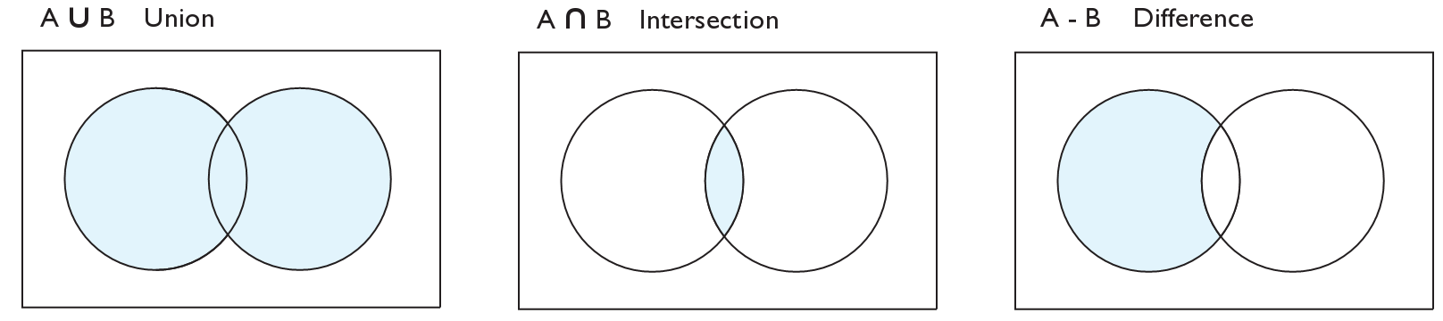
Set operations
addAll
retainAll
removeAll
addAll(collection) | adds all elements from the given collection to this set
containsAll(coll) | returns true if this set contains every element from given set
equals(set) | returns true if given other set contains the same elements
iterator() | returns an object used to examine set's contents (seen later)
removeAll(coll) | removes all elements in the given collection from this set
retainAll(coll) | removes elements not found in given collection from this set
toArray() | returns an array of the elements in this set

Slide 100
Sets and ordering
HashSet : elements are stored in an unpredictable order
  Set<String> names = new HashSet<String>();
  names.add("Jake");
  names.add("Robert");
  names.add("Marisa");
  names.add("Kasey");
  System.out.println(names);
  // [Kasey, Robert, Jake, Marisa]
TreeSet : elements are stored in their "natural" sorted order
  Set<String> names = new TreeSet<String>();
  ...
  // [Jake, Kasey, Marisa, Robert]
LinkedHashSet : elements stored in order of insertion
  Set<String> names = new LinkedHashSet<String>();
  ...
  // [Jake, Robert, Marisa, Kasey]

Slide 101
The "for each" loop (7.1)
for (type name : collection) {
statements;
}
Provides a clean syntax for looping over the elements of a Set, List, array, or other collection
  Set<Double> grades = new HashSet<Double>();
  ...
  for (double grade : grades) {
  System.out.println("Student's grade: " + grade);
  }
  needed because sets have no indexes; can't get element i

Slide 102
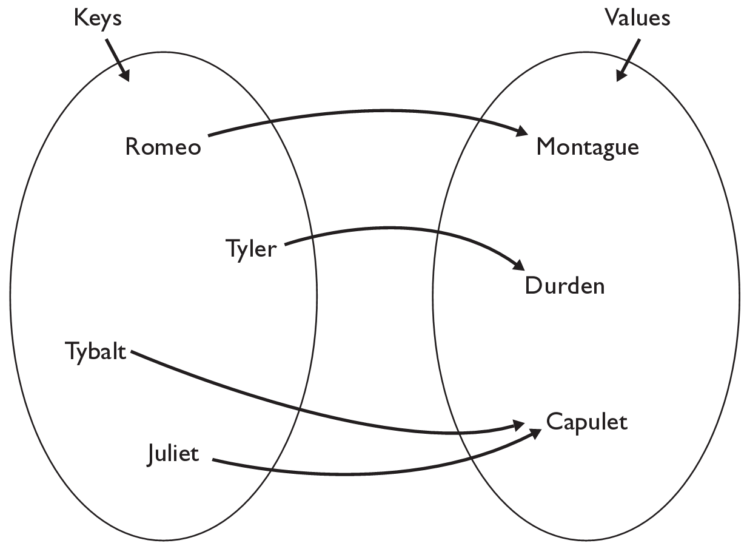
The Map ADT
map: Holds a set of unique keys and a collection of values, where each key is associated with one value.
  a.k.a. "dictionary", "associative array", "hash"
basic map operations:
  put(key, value ): Adds a
  mapping from a key to
  a value.
  get(key ): Retrieves the
  value mapped to the key.
  remove(key ): Removes
  the given key and its
  mapped value.
myMap.get("Juliet") returns "Capulet"

Slide 103
Map concepts
a map can be thought of as generalization of a tallying array
  the "index" (key) doesn't have to be an int
recall previous tallying examples from CSE 142
  count digits: 22092310907
  // (M)cCain, (O)bama, (I)ndependent
  count votes: "MOOOOOOMMMMMOOOOOOMOMMIMOMMIMOMMIO"
index | 0 | 1 | 2 | 3 | 4 | 5 | 6 | 7 | 8 | 9
value | 3 | 1 | 3 | 0 | 0 | 0 | 0 | 1 | 0 | 2
"M"
14
key | "M" | "O" | "I"
value | 16 | 14 | 3
"O"
3
"I"
16
keys
values

Slide 104
Map implementation
in Java, maps are represented by Map interface in java.util
Map is implemented by the HashMap and TreeMap classes
  HashMap: implemented using an array called a "hash table";
  extremely fast: O(1) ; keys are stored in unpredictable order
  TreeMap: implemented as a linked "binary tree" structure;
  very fast: O(log N) ; keys are stored in sorted order
  A map requires 2 type parameters: one for keys, one for values.
// maps from String keys to Integer values
Map<String, Integer> votes = new HashMap<String, Integer>();

Slide 105
Map methods
put(key, value) | adds a mapping from the given key to the given value; if the key already exists, replaces its value with the given one
get(key) | returns the value mapped to the given key (null if not found)
containsKey(key) | returns true if the map contains a mapping for the given key
remove(key) | removes any existing mapping for the given key
clear() | removes all key/value pairs from the map
size() | returns the number of key/value pairs in the map
isEmpty() | returns true if the map's size is 0
toString() | returns a string such as "{a=90, d=60, c=70}"
keySet() | returns a set of all keys in the map
values() | returns a collection of all values in the map
putAll(map) | adds all key/value pairs from the given map to this map
equals(map) | returns true if given map has the same mappings as this one

Slide 106
Using maps
A map allows you to get from one half of a pair to the other.
  Remembers one piece of information about every index (key).
  Later, we can supply only the key and get back the related value:
    Allows us to ask: What is Joe's phone number?
// key value
put("Joe", "206-685-2181")
Map
get("Joe")
Map
"206-685-2181"

Slide 107
Maps vs. sets
A set is like a map from elements to boolean values.
  Set: Is Joe found in the set? (true/false)
  Map: What is Joe's phone number?
"Joe"
Set
true
false
"Joe"
Map
"206-685-2181"

Slide 108
keySet and values
keySet method returns a Set of all keys in the map
  can loop over the keys in a foreach loop
  can get each key's associated value by calling get on the map
  Map<String, Integer> ages = new TreeMap<String, Integer>();
  ages.put("Joe", 19);
  ages.put("Geneva", 2); // ages.keySet() returns Set<String>
  ages.put("Vicki", 57);
  for (String name : ages.keySet()) { // Geneva -> 2
  int age = ages.get(name); // Joe -> 19
  System.out.println(name + " -> " + age); // Vicki -> 57
  }
values method returns a collection of all values in the map
  can loop over the values in a foreach loop
  no easy way to get from a value to its associated key(s)

Slide 109
Priority queue ADT
priority queue: a collection of ordered elements that provides fast access to the minimum (or maximum) element
  usually implemented using a tree structure called a heap
priority queue operations:
  add adds in order; O(log N) worst
  peek returns minimum value; O(1) always
  remove removes/returns minimum value; O(log N) worst
  isEmpty,
  clear,
  size,
  iterator O(1) always

Slide 110
Java's PriorityQueue class
public class PriorityQueue<E> implements Queue<E>
Queue<String> pq = new PriorityQueue<String>();
pq.add("Stuart");
pq.add("Marty");
...
Method/Constructor | Description | Runtime
PriorityQueue<E>() | constructs new empty queue | O(1)
add(E value) | adds value in sorted order | O(log N )
clear() | removes all elements | O(1)
iterator() | returns iterator over elements | O(1)
peek() | returns minimum element | O(1)
remove() | removes/returns min element | O(log N )

Slide 111
Priority queue ordering
For a priority queue to work, elements must have an ordering
  in Java, this means implementing the Comparable interface
Reminder:
  public class Foo implements Comparable<Foo> {
  …
  public int compareTo(Foo other) {
  // Return positive, zero, or negative number
  }
  }

